Slide 1
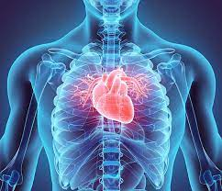
Cardiovascular Disease
Prepared By:
KESAVA SAI RAAM C N

Slide 2
Contents:
Introduction
Agenda
Problem statement
Understanding the variable
Process followed in the project
Illustration of some plots
Model
Result

Slide 3
Introduction
The main motivation of doing this research is to present a heart disease prediction model for the prediction of occurrence of heart disease
Machine learning proves to be effective in assisting in making decisions and predictions from the large quantity of data produced by the health care industry.
It is difficult to identify heart disease because of several contributory risk factors such as diabetes, high blood pressure, high cholesterol, abnormal pulse rate and many other factors.

Slide 4
Agenda
The diagnosis of heart disease is a challenging task, which can offer automated prediction about the heart condition of patient so that further treatment can be made effective.
The diagnosis of heart disease is usually based on signs, symptoms of the patient. The major challenge in heart disease is its detection.
The severity of the disease is classified based on various methods like Naive Bayes

Slide 5
Problem statement
There are instruments available which can predict heart disease but either it are expensive or are not efficient to calculate chance of heart disease in human. Early detection of cardiac diseases can decrease the mortality rate and overall complications.
It is not possible to monitor patients everyday in all cases accurately and consultation of a patient for 24 hours by a doctor is not available since it requires more sapience, time and expertise.
Since we have a good amount of data in today’s world, we can use various machine learning algorithms to analyze the data for hidden patterns.

Slide 6
Understanding the variable
Id
age
gender
height
weight
cholesterol
gluc
smoke
alco
active
cardio
In this project all the included columns are used for the analysis and prediction.

Slide 7
Process followed in the project
Cleaning of data
Building a model using machine learning algorithms.
Training the model to predict the chances of heart attack/diseases.

Slide 8
Procedure followed for cleaning the dataset.
Removing duplicate or irrelevant observations.
Filtering the unwanted outliers from the blood pressure variables.
Handling the missing data.
Using info() function to verify if there are any missing values.
Using isnull() function to check the null values.

Slide 9
Changes in columns in EDA Process
The patients age is written in days, so we're converting it to years and rounding it to the nearest 2 decimals.
we're replacing the gender column with another two-columns, one for male and the other is for female.
If the patients' gender is male then a value of 1 will be inside the male column and zero inside the female column and vice-versa.
we're calculating the patient BMI (Body Mass Index) using the formula which is: weight/height^2.
The height of patients were in centimeters so we divided it by 100 to convert it into meters.

Slide 10
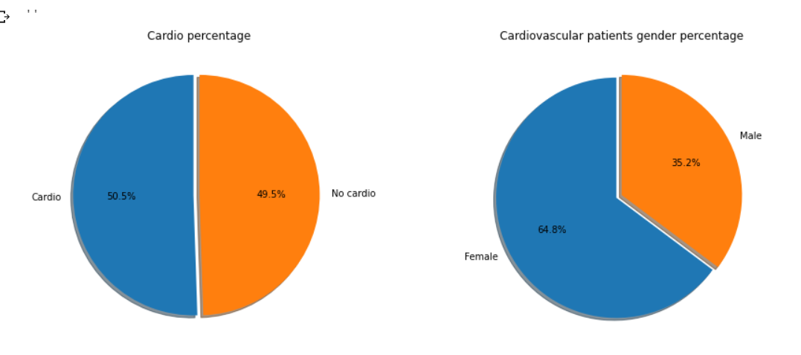
Analyzing an visualizing the data The percentage of males with cardiovascular diseases is 35.3%. The percentage of females with cardiovascular diseases is 64.7%.

Slide 11
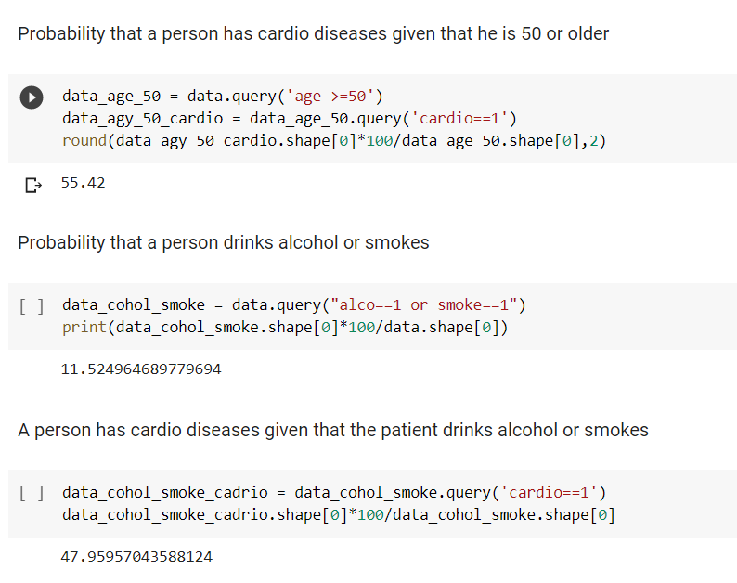
Probabilities according to the condition for analyzing purpose

Slide 12
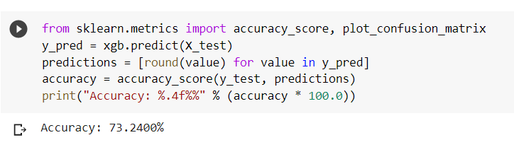
Accuracy achieved in the project

Slide 13


